Slide 1


Slide 2


Slide 3


Slide 4


Slide 5


Slide 6


Slide 7


Slide 8
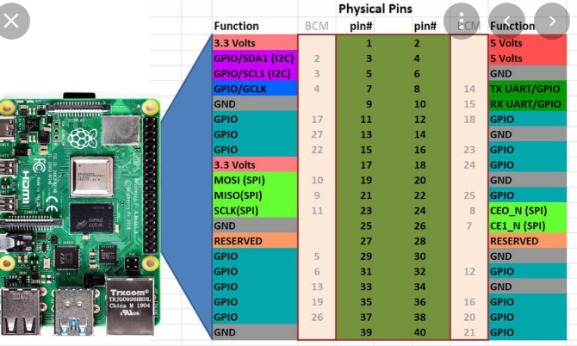

Slide 9


Slide 10
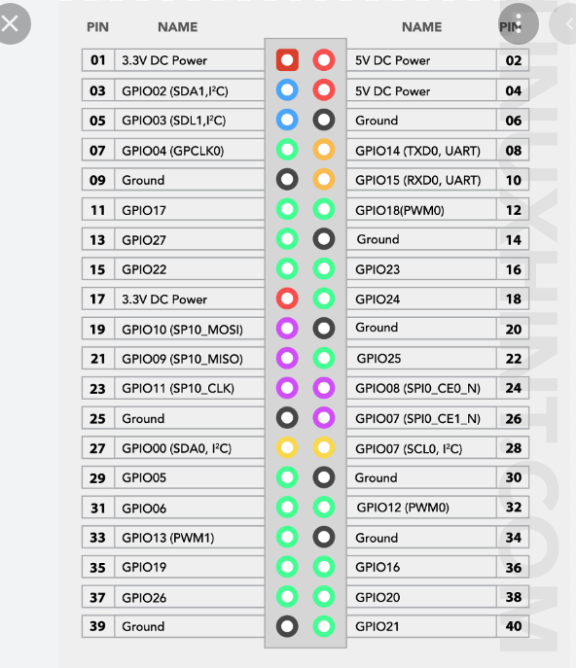
Pin Layout

Slide 11
Pin Numbering Schemes
Pin Numbering schemes
Physical Pin
Broadcom Pin Numbering
Wiring-pi
from gpiozero import LED
led =LED(16) # using default numbering scheme : BCM
led =LED(“BCM16”) # using BCM numbering scheme
led =LED(“BOARD36”) # using physical pin numbering
led =LED(“WPI27”) # using physical wiring-pi pin numbering
gpiozero library uses BroadCoM (BCM) pin numbering scheme
By default

Slide 12


Slide 13


Slide 14


Slide 15


Slide 16


Slide 17
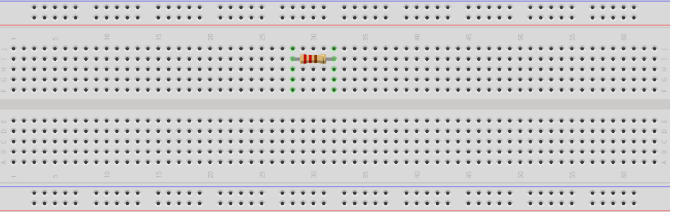
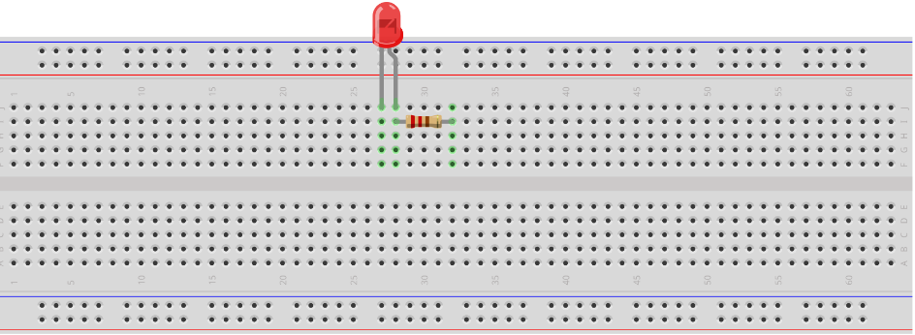
For the hardware configuration, we will first place a resistor of 220 ohms on a breadboard:
Next step is to connect the anode pin of the LED with one leg of the resistor:

Slide 18
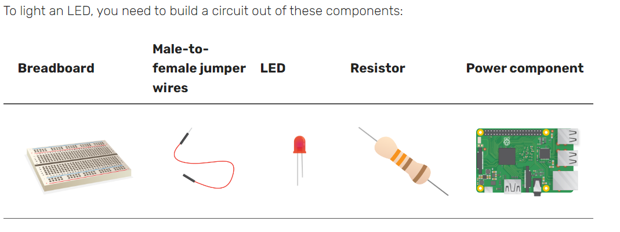
To Light a LED
The long leg of LED is the positive leg, and also called the anode. It should always be connected to the positive side of a circuit. The short leg is the negative leg, called the cathode. It needs to be connected to the negative side.

Slide 19
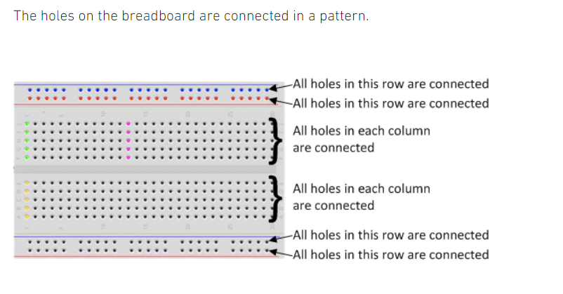
Breadboard

Slide 20
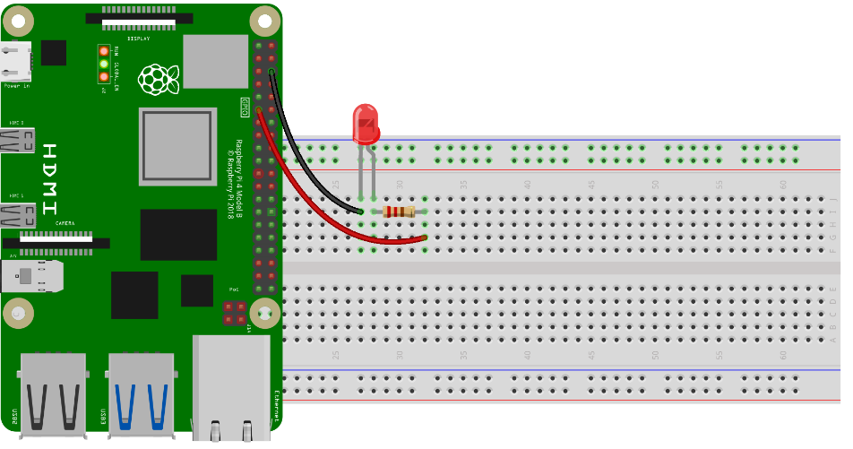
Resistor is connected
to the positive side
Of the LED, in the
Same column

Slide 21
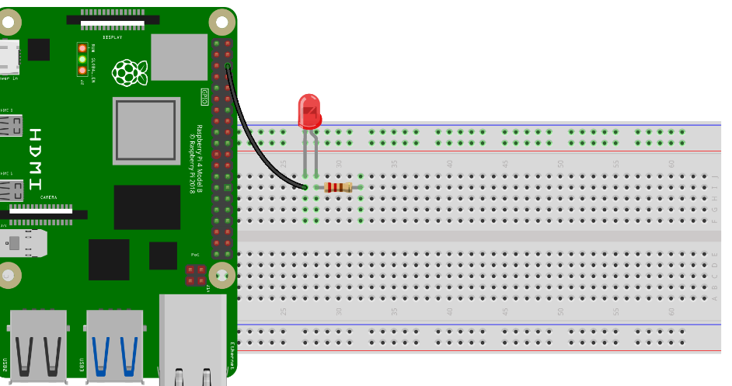
After connecting anode of LED, we will connect the cathode terminal of the LED with the ground GPIO of Raspberry Pi 4:

Slide 22
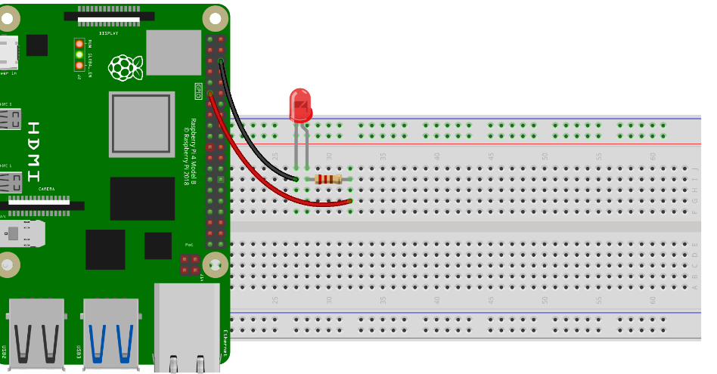
In a final step, connect the 17 GPIO of Raspberry Pi 4 with the open terminal of resistor:

Slide 23
write the following Python code to control the LED:
import RPi.GPIO as GPIO #include GPIO library
import time # include time library
ledpin = 17 # selecting a pin to be used for connecting LED
GPIO.setwarnings(False) # Disable warnings
GPIO.setmode (GPIO.BOARD) # physical pin numbering scheme is followed
# GPIO.BCM uses BroadCom numbering scheme
GPIO. setup ( ledpin , GPIO.OUT) # selected pin is configured as output
GPIO. output ( ledpin, True) # write high voltage on the led pin
# to turn the LED on
time.sleep (5) # sleep for 5 seconds
GPIO. output ( ledpin, False) # write low voltage on the led pin
# to turn the LED off
GPIO.cleanup() # clear GPIO pins

Slide 24


